Slide 1

Introduction to Software Architecture
Software Architecture
3rd Year – Semester 1
Lecture 1
By Udara Samaratunge

Slide 2
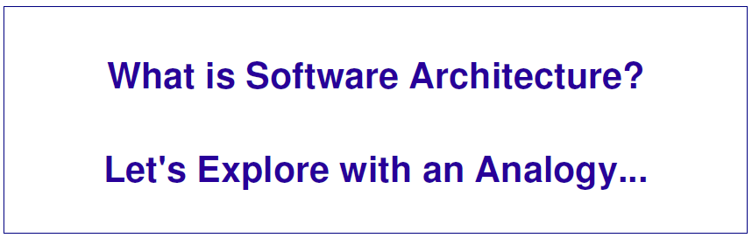

Slide 3
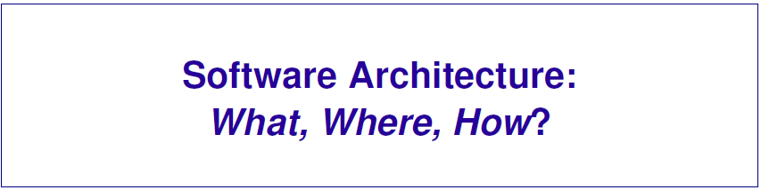

Slide 4
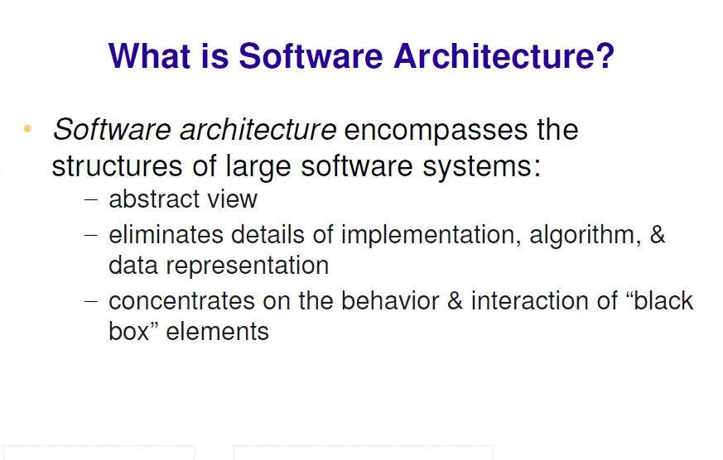

Slide 5
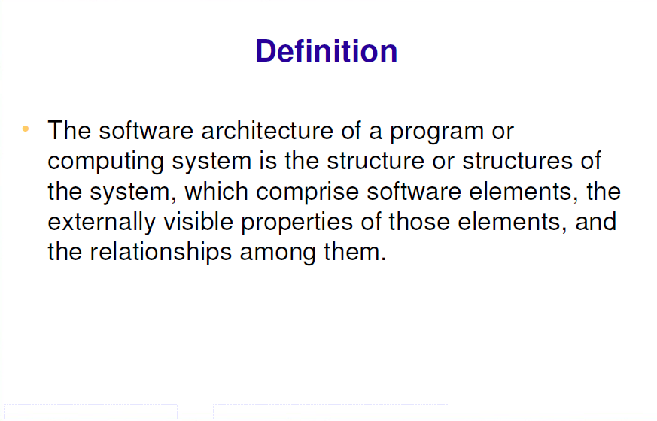

Slide 6
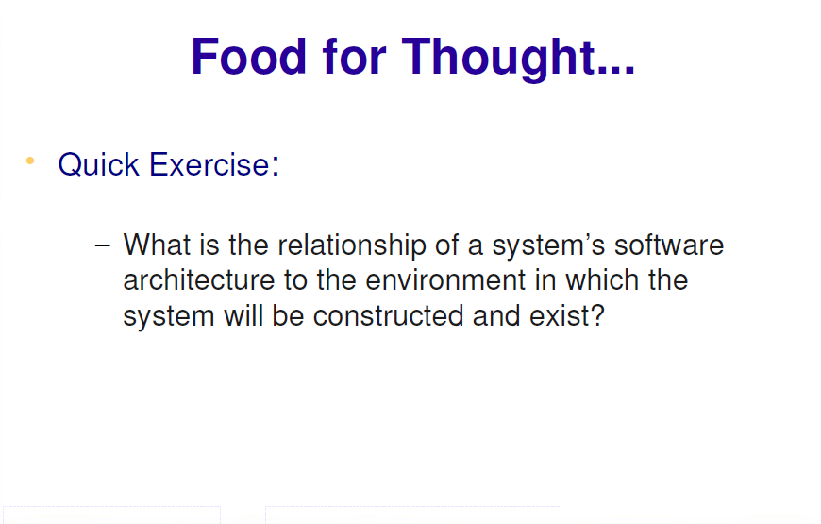

Slide 7
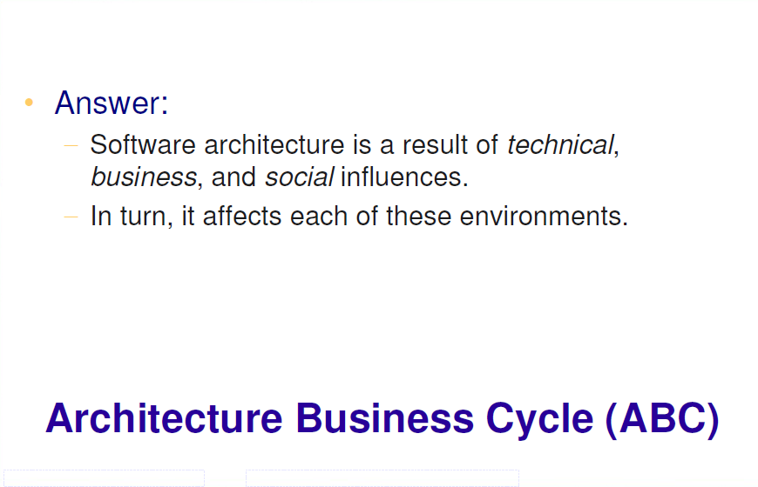

Slide 8
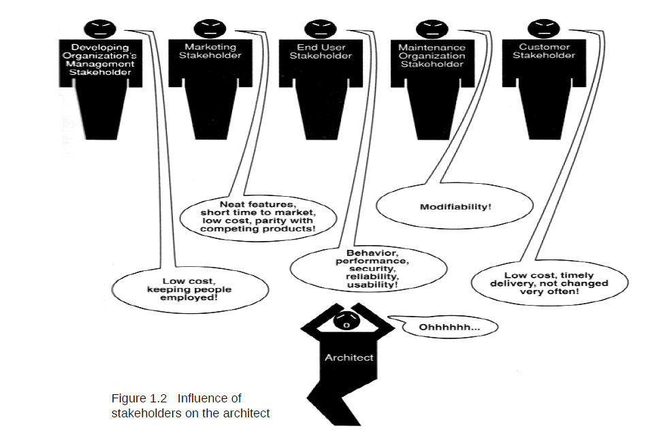

Slide 9
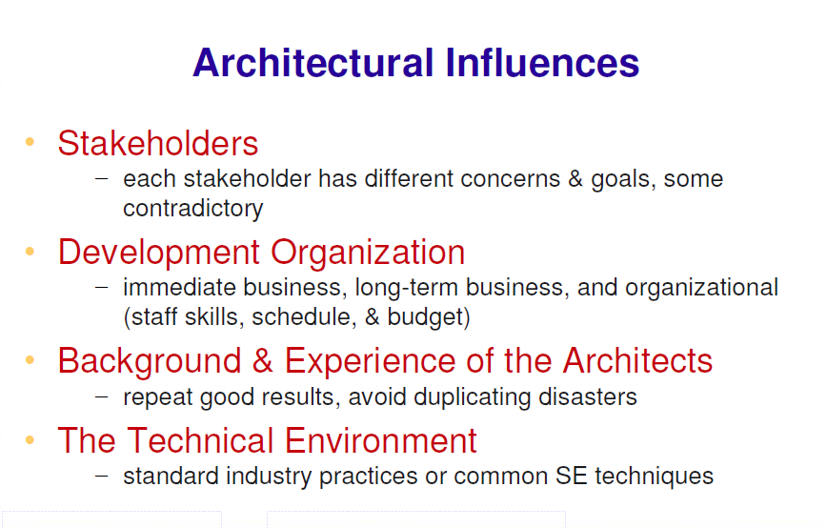

Slide 10
Software Architecture Patterns

Slide 11
Software Architecture Patterns
Why Use a Pattern?
Proven construct
Easy to communicate
Keep things in order

Slide 12
Software Architecture Patterns
Layered Architecture
Event-Driven Architecture
Microkernel Architecture
Micro services Architecture

Slide 13
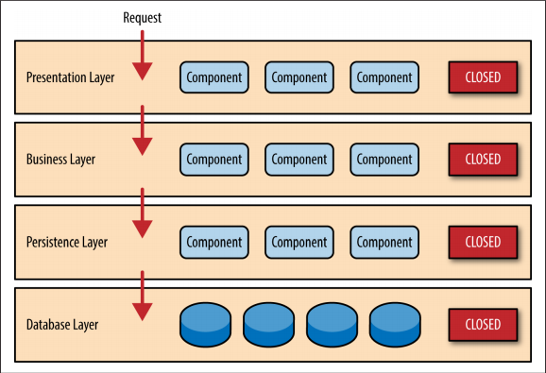
Layered Architecture

Slide 14
Key Concepts
Separation of concerns
Layers’ Isolation
Open/Closed Layers

Slide 15
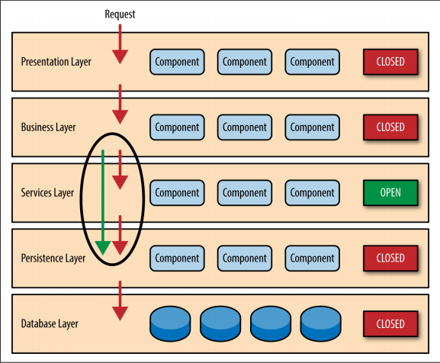
Open/Closed Layers

Slide 16
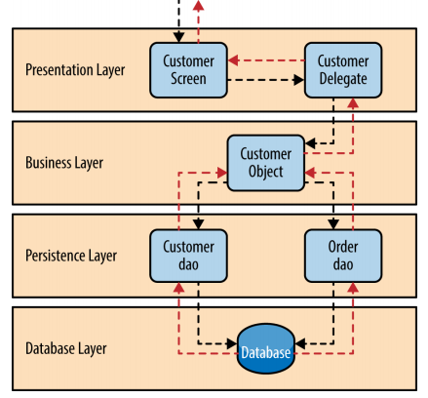
Pattern Example

Slide 17
The Architecture Sinkhole Anti-Pattern
Requests flow through layers without processing

Slide 18
Layered Architecture Pattern Analysis
Overall Agility - Low
Ease of Deployment - Low
Testability - High
Performance - Low
Scalability - Low
Ease of Development - High

Slide 19
Event Driven Architecture
Distributed
Asynchronous
Highly scalable
Highly adaptable
Two main topologies:
Mediator
Broker

Slide 20
Mediator Topology
Events processing have multiple steps that require orchestration
Four main components:
Event Queues
Event Mediator
Event Channels
Event Processors

Slide 21
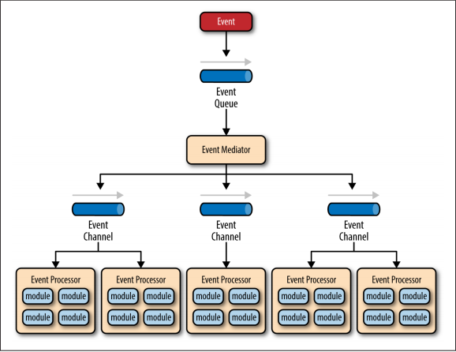
Mediator Topology

Slide 22
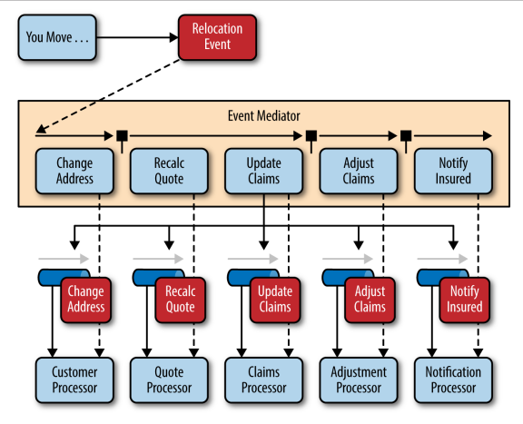
Mediator Topology Example

Slide 23
Broker Topology
No central event mediator
Message flows across processors in a chain like fashion
Main components:
Message Broker
Event Processor

Slide 24
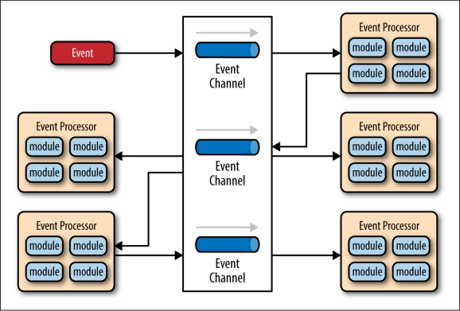
Broker Topology

Slide 25
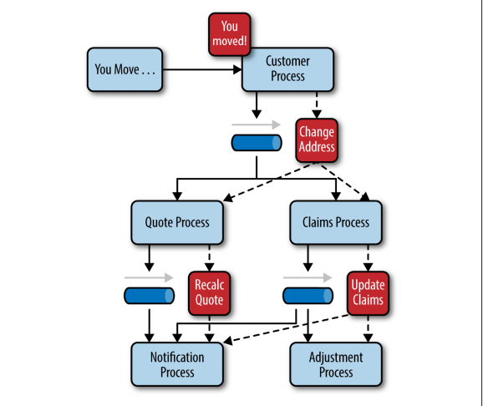
Broker Topology Example

Slide 26
Microkernel Architecture

Slide 27
Microkernel Architecture
Plugin Architecture Pattern
Natural for Product Based Apps
Consists of:
Core System
Plugins
Can be embedded in other patterns

Slide 28
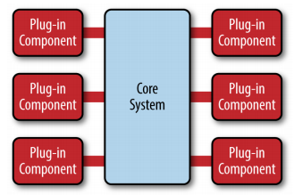
Microkernel Architecture

Slide 29
Microkernel Pattern Analysis
Overall Agility - High
Ease of Deployment - High
Testability - High
Performance - High
Scalability - Low
Ease of Development - Low

Slide 30
Micro services Architecture

Slide 31
Micro services
Evolved from other patterns
Alternative to Monolithic Applications and SOA Architecture
Still evolving
Many ways to implement

Slide 32
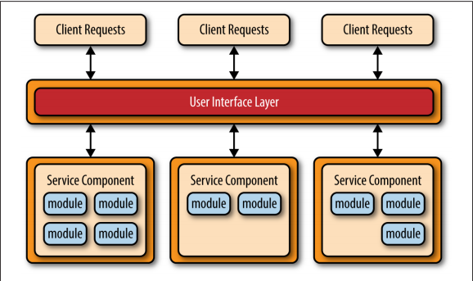
Basic Layout

Slide 33
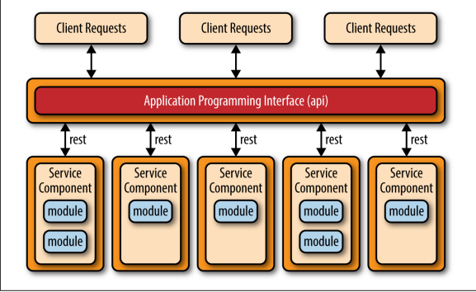
API REST-Based

Slide 34
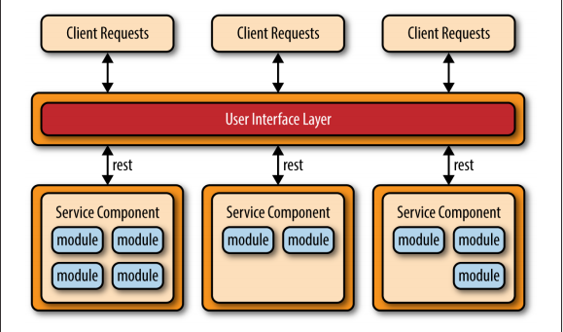
Application REST-based

Slide 35
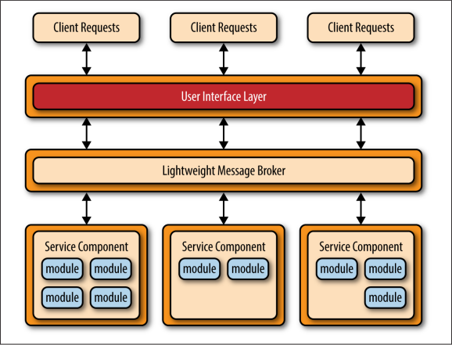
Centralized Messaging Topology

Slide 36
Micro Services Architecture Pattern Analysis
Overall Agility - High
Ease of Deployment - High
Testability - High
Performance - Low
Scalability - High
Ease of Development - High

Slide 37
Pattern Comparison
Layered Pattern | A solid general purpose pattern - best when you are not sure. Avoid the “Sinkhole Anti-Pattern” Tends to encourage Monolithic Applications
Event-Driven | Relatively complex. Distributed architectures issues must be addressed, such as remote processor availability, lack of responsiveness, reconnection logic, and failure recovery. No transactions across processors. Difficult to create and maintain processor contracts
Microkernel | Can be embedded and used within other patterns. Great support for evolutionary design and incremental development. Should always be the first choice for product-based applications
Microservices | Easy to perform real-time production deployments. Very agile-oriented architecture Shares complexity issues with data-driven pattern

Slide 38
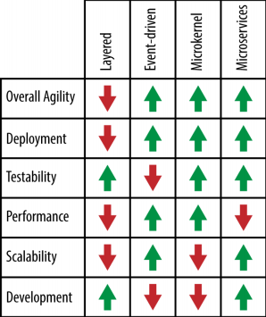
Pattern Comparison

Slide 39
The End

